Slide 1
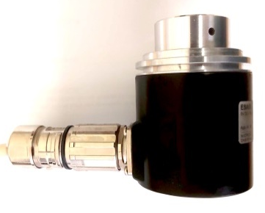
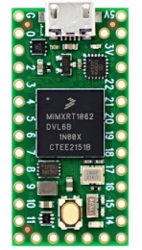


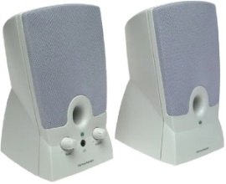



Cardiac Interoceptive Task (Circuit Diagram)
USB data lead to computer
1
2
13 Bit Gray Code Encoder ESA58.2135.G13.2
Teensy 4.0 MPU
5V
3
4
5
6
7
8
9
10
11
12
13
14
15
D0
D1
D2
D3
D4
D5
D6
D7
D8
D9
D10
D11
D12
25 Pin D-Type Connectors
2m length
470nF
Speakers should have a 3.5mm jack plug for audio input
3.5mm jack socket (for computer speakers)
Ground of the Teensy should be connected to pins 24 & 25 of the D-type female connector. The 5v from the Teensy board should be connected to pins 1 & 2 of the female D-type connector. D0 of the Teensy should be connected to pin 3, D1 to pin 4, D2 to pin 5, …. D12 to pin 15 of the female D-type connector.
-----------------------------------------------------------------------------------------------------------
The 5v supply to the encoder (pin 1) should be connected to pins 1 & 2 of the D-type male connector, encoder ground (pin 2) should be connected to pins 24 & 25. Encoder data input pins (3-15) should be connected such that pin 3 is connected to pin 3 of the male D-type connector, pin 4 to pin 4 of the connector, …. pin 15 of the encoder is connected to pin 15 of the D-type connector.
GND
BNC Socket for R-Wave TTL pulse input
ABS plastic enclosure to house circuit and connectors

